Slide 1
Table Test
 | Favorite Sports | Age
Amy | Badminton | 20
Bob | Jogging | 19
Cindy | swimming | 25

Slide 2
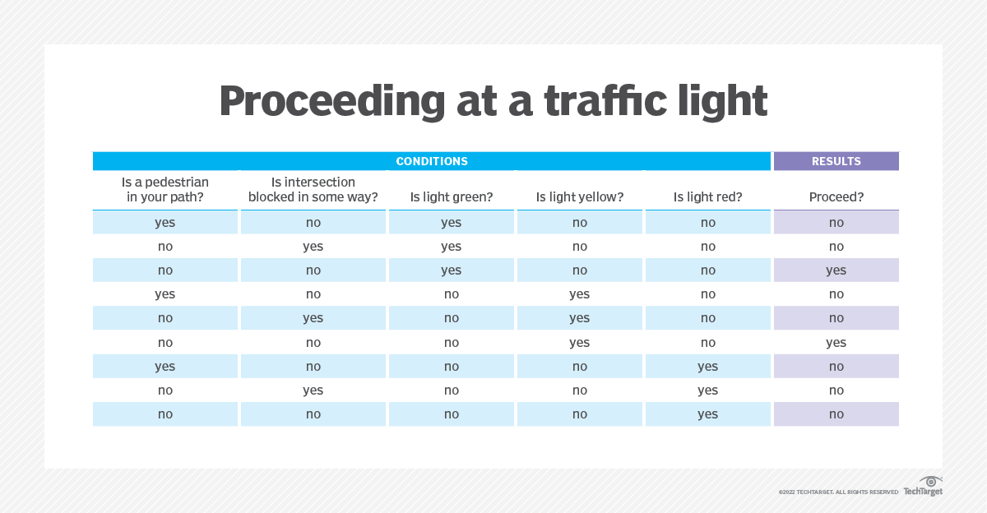
A table in the image

